Slide 1
Great Teams Know Their Customer
Tim Roesch, Virginia Department of Education

Slide 2
Agenda
Importance of Knowing our Customer
Agile Practices that Promote Customer Understanding
Tools for Deepening Customer Understanding
Case Study: VSP
Role of Leadership

Slide 3
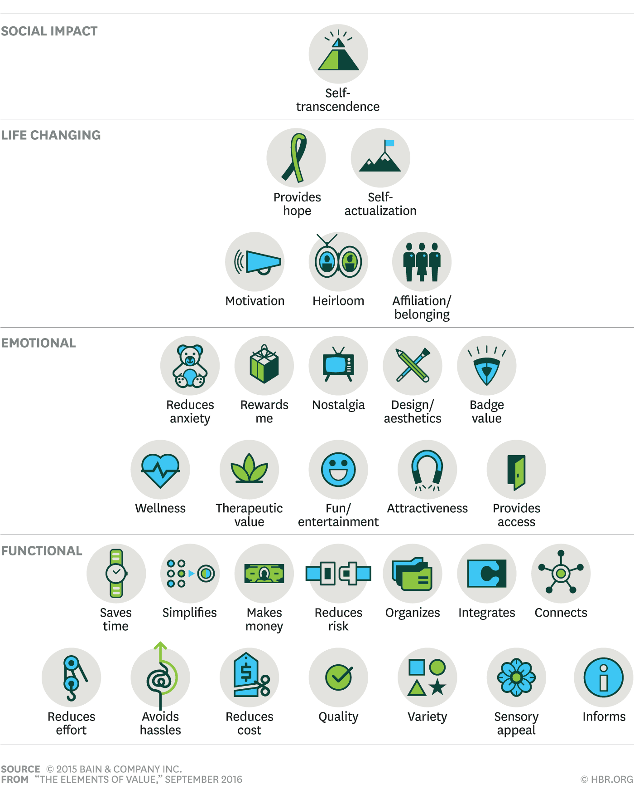
The Importance of Knowing Our Customer
Our customer defines value
Understanding customer needs and pain-points drives the development process
Enhances the ability to deliver value continuously
Agile Manifesto: Agile emphasizes customer collaboration over contract negotiation
Agile Principle: “Customer satisfaction through early and continuous delivery of valuable software.”

Slide 4
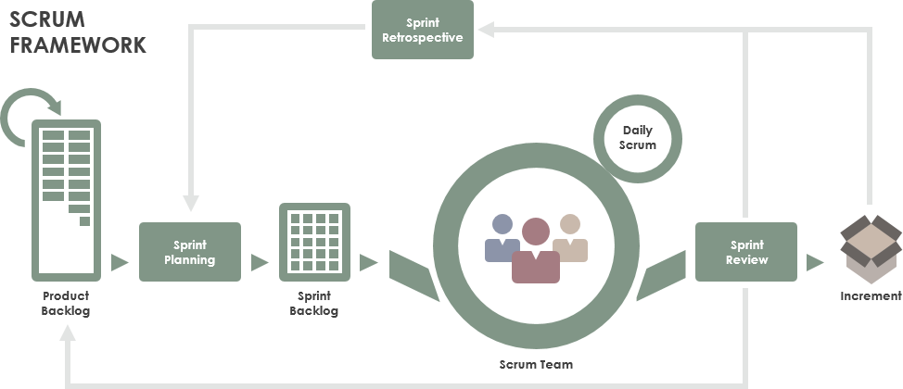
Agile Practices That Promote
Customer Understanding
Customer Involvement:
  Prioritizing features that deliver maximum business value
Product Owner:
  The primary point of contact on behalf of the customer to identify the product requirements for the development team
User Stories:
  Helps teams focus on delivering features that matter most to the customer
Regular Feedback Loops:
  Iterative development
  Course correction based on real-time input

Slide 5
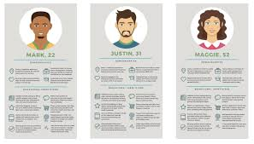
Tools for Deepening Customer Understanding
Personas:
  Create detailed customer personas to guide development decisions
  Ensure that the team stays aligned with customer demographics, needs, and behaviors

Slide 6
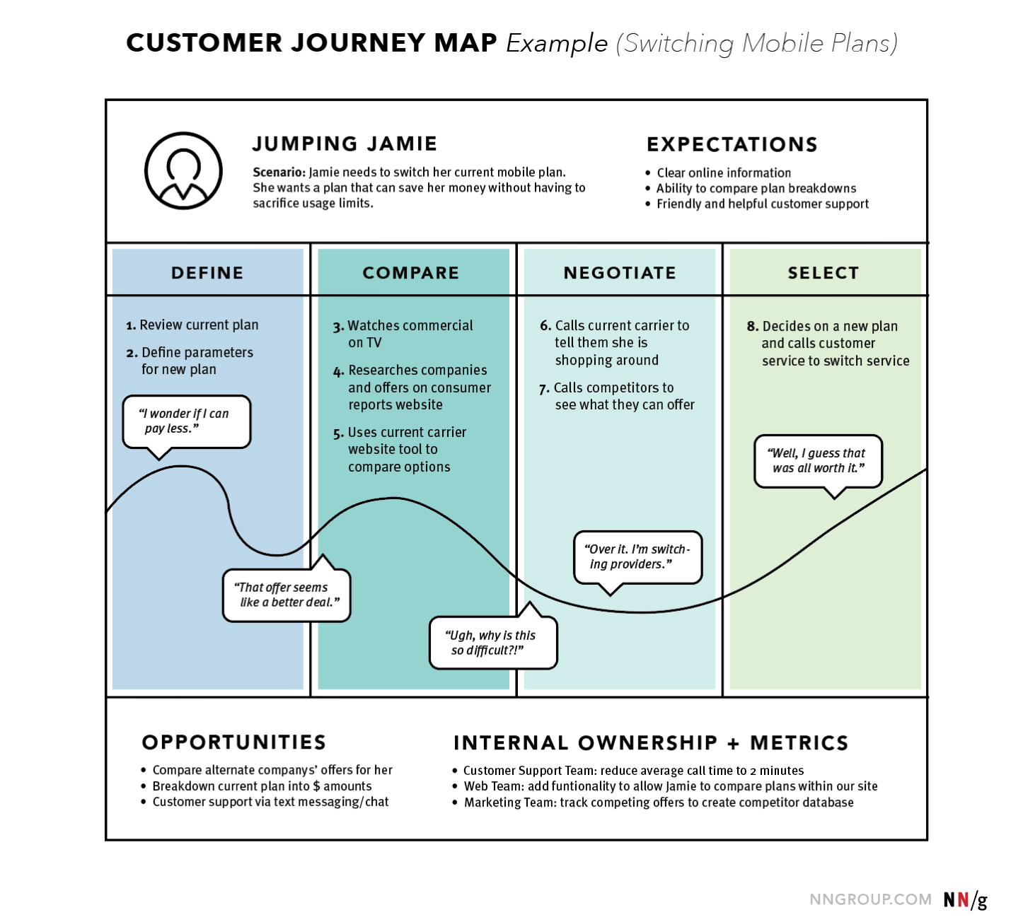
Tools for Deepening Customer Understanding
Journey Mapping:
  Maps out the customer journey to identify touchpoints and pain points
  Helps in designing software that meets customer needs at every stage

Slide 7
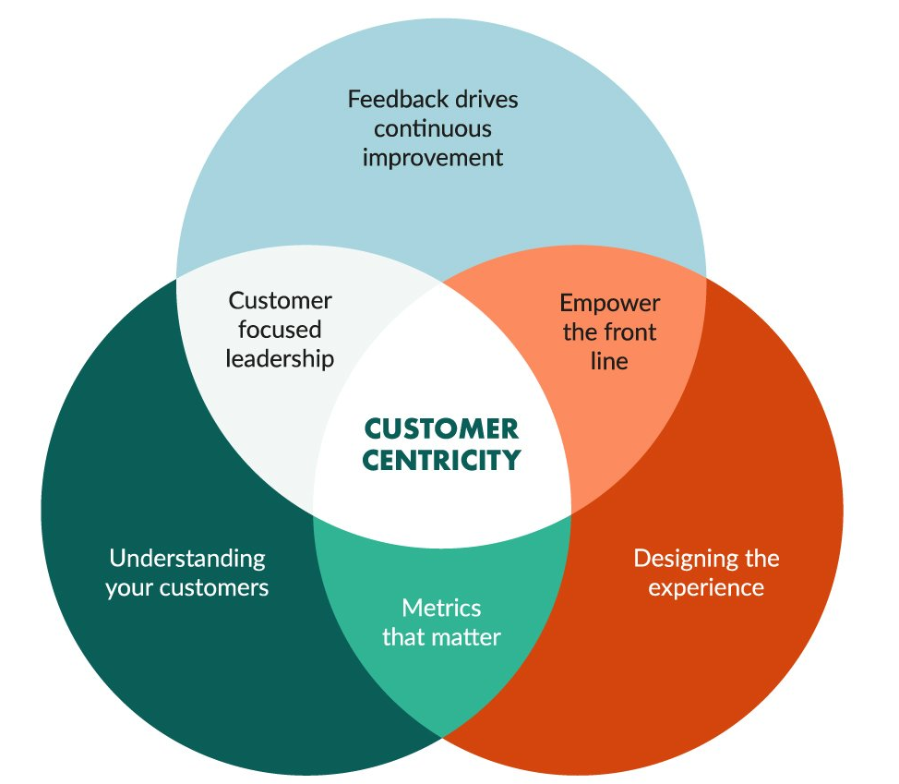
The Role of Leadership in Promoting
Customer-Centricity
Leadership Actions:
  Encourage a customer-first mindset across the organization
  Facilitate regular interactions between development teams and customers
  Foster a culture of continuous learning and adaptation based on customer feedback
Outcome:
  A unified organization where everyone, from developers to executives, understands and acts upon customer needs

Slide 8
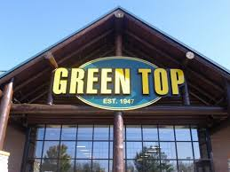
Case Study: Successful Agile Transformation Through Customer Focus
Case Example: VCHECK2 at VSP
  Development Team met with the Firearms Transaction Team (FTC) to understand pain-points experienced by that group
  Development Team did a field trip to Green Top to discover firearms-purchasing process from the perspective of both Sellers and Buyers of firearms
Results:
  Increased external and internal customer satisfaction

Slide 9
Levels of Knowing our Customer
Level 5
  Engineers meet regularly with customers, asking questions and observing how they interact with the product
  Engineers join customer calls & usability tests
  Engineers take part in design discussions & early brainstorms
Level 3
  Engineers are occasionally involved in customer meetings
  Engineers contribute some product direction but primarily work from a backlog defined by Product Management
Level 1
  Engineers never meet with customers
  Engineers take direction solely from customer proxies, like Scrum Product Owners

