Slide 1
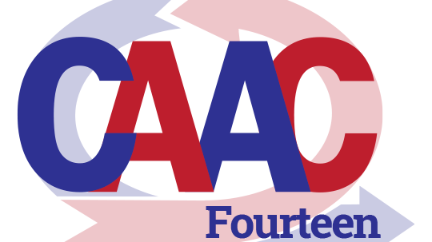
Notes:
Start the video at 8:47

Slide 2
meeting etiquette
This meeting is being recorded
If you have a camera, please use it; we’d love to see you!
Please mute all phones/mics/ speakers unless you’re speaking
Add questions/ comments to meeting chat if you like – someone will be watching!
We will break for questions/ comments after each session
To unmute on your phone, you may have to press *6
Notes:
This goes up at 8:59

Slide 3
Commonwealth Agency Agile Conference #14
The Team's the Thing: Growing an Agile Culture in State Government
November 1, 2024
Notes:
Good morning, and welcome to CAAC14, The Team's the Thing: Growing an Agile Culture in State Government. We have a great morning we have planned for you – we've gone halfway across the country to find our first speaker, and I'm really interested in what he's going to discuss with us. But before we dive into today’s agenda and introduce those folks to you, just a little bit of housekeeping....

Slide 4
For tech support during the conference
PSA # 1
Teams Chat with Julie Wilson,
Or send an email to:
julie.wilson@vsp.virginia.gov
Notes:
For our first public service announcement of the morning: Julie Wilson is from IT, and she’s here to help. If you run into technical difficulties kind of trouble this morning, please chat or email with Julie, and she’ll get it sorted out for you if there is sorting to be done. Note: If you look up Julie in Teams, you’ll need to know that her first name is actually Julianna. Now let’s get things rolling.

Slide 5
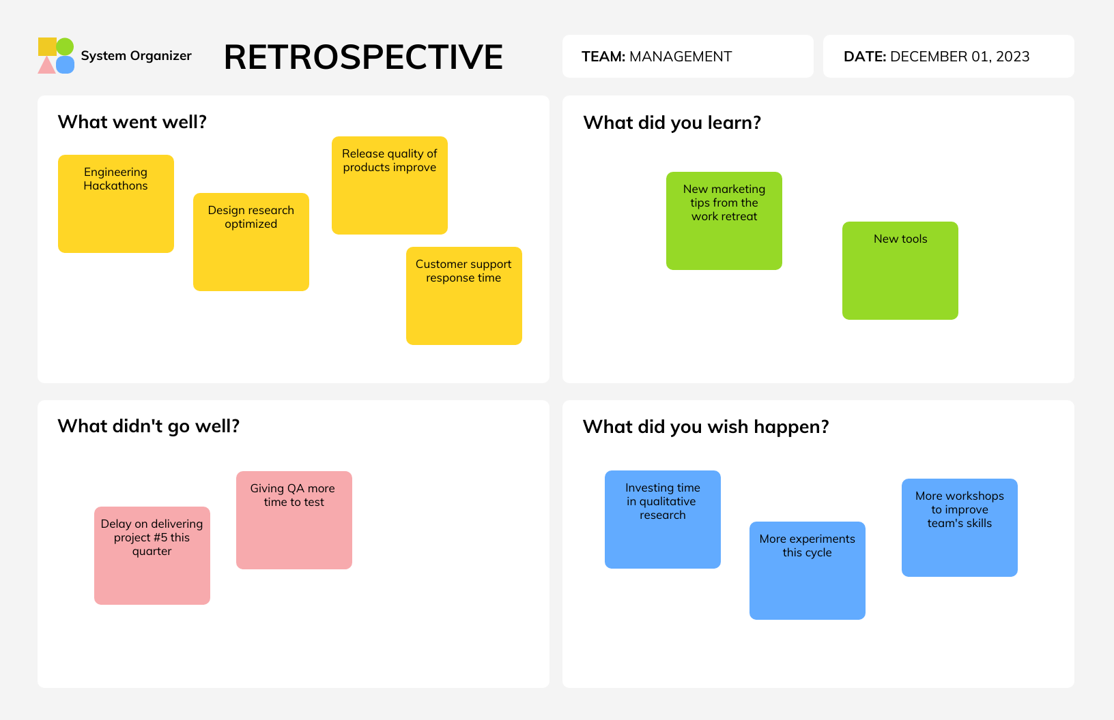
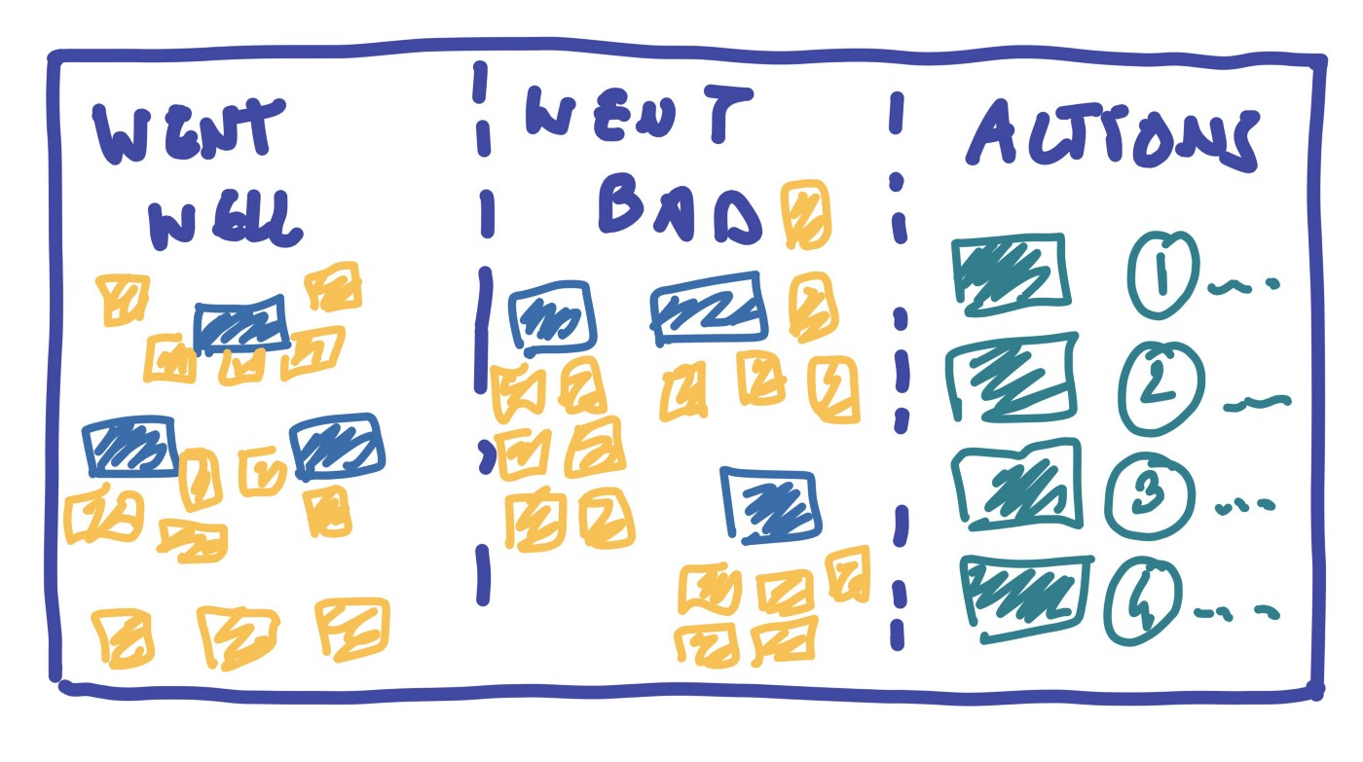
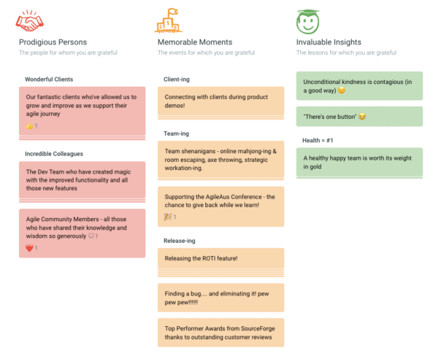
Today’s Retrospective
Notes:
But first, before all that, Niaz is going to get us started on today’s Retrospective. Niaz, what instructions do you have for us this morning?
We will be asking for your opinions and suggestions at the end of the morning, just as we always do. So as you're listening and participating in the sessions today, if you find yourself thinking "ooh, that was well done!" Or "I wish they'd do this", make a note of it so you can add it to the board later.
The Retrospective will use The COV Office 365 Whiteboard widget, so if you don't have a "virginia.gov" email address, you probably won't be able to get to the whiteboard. However, all is not lost! If you'll put your comments in the meeting's chat, we'll catch them and add them to the whiteboard for you.
Your opinions really do matter to us – that's why we set aside this time in every CAAC. Please, please, please – participate! Let us know what you really think about today's conference, both good and bad, and about what we can do in the future to make this a more valuable experience for you and for everyone else in attendance.

Slide 6
schedule
Topic | Start Time | # minutes | Who?
Opening Conversation | 9:00 | 15 | Stephen
Session 1: Grow Agility: Evolve or ... | 9:15 | 60 | Dhaval
-- break -- | 10:15 | 15
Session 2: Good to Great: Agile Culture in VSP IT | 10:30 | 60 | Stephen, Tim, and Gurinderpreet
Conference Retrospective | 11:30 | 25 | Niaz
Closing Comments | 11:55 | 5 | Stephen
Notes:
For our first session this morning, we will start the discussion about Agile Culture with the somewhat ominous title Grow Agility: Evolve or …, followed by our usual break at 10:15. Then our second session takes a deeper dive into what we've done to encourage Being Agile at VSP. After that, we'll have our retrospective and close out the morning.

Slide 7
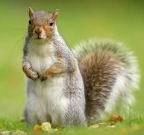
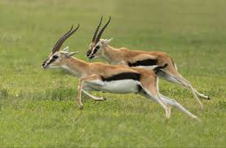
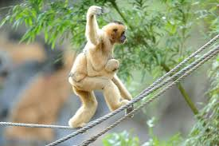
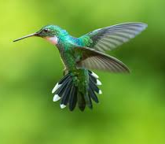
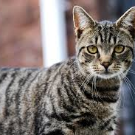
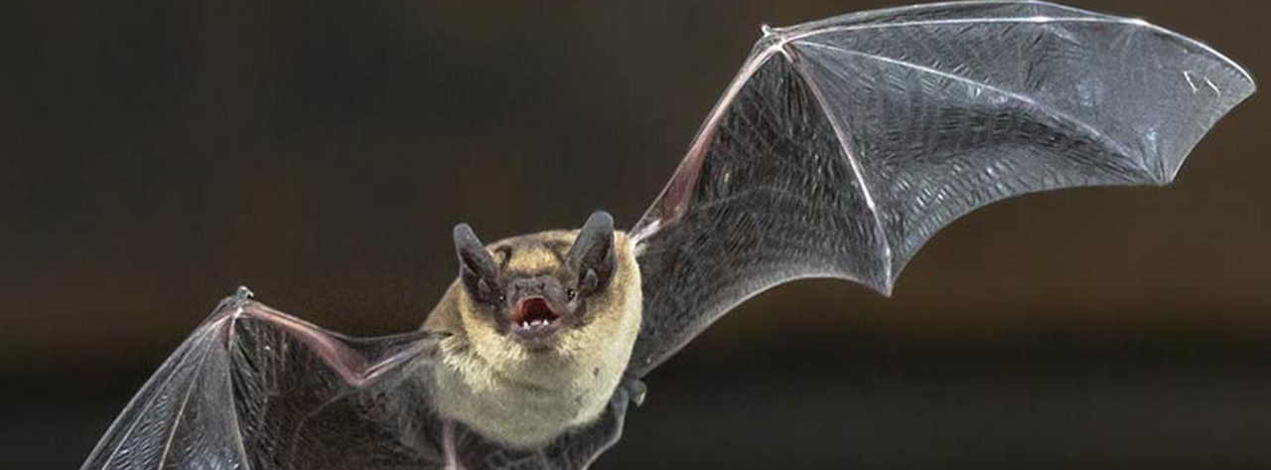
Notes:
Animals Typically on "Most Agile" Lists:
Gazelles
Squirrels
Cats
Bats
Hummingbirds
Gibbons
My question is – why? what makes these creatures "agile"? That's not a rhetorical question, by the way – please either put your answer in the chat, or unmute and speak up – what makes an animal Agile?
balance
coordination
speed
Able to change directions suddenly
Quick reaction time
strength
flexibility
maneuverability
If you were to rank these animals from Most Agile to Least Agile, how would you sort them? In fact, let's do that … arrange this list from Most to Least Agile, most agile on top.
Was that hard to do? Why? What were you thinking about when do chose your Most Agile Animal?

Slide 8
Animal Agility Team Agility
balance
coordination
speed
quick reaction time
strength
flexibility
maneuverability
balance
quick reaction time
speed
flexibility
communication
trust
self-management
Notes:
Now, moving into our world of Agility in state government – do we use any of these characteristics when we’re talking about "Being Agile"? Well, some will cross over, right? We certainly talk about teams being being well-balanced, able to change directions quickly, Being fast to market, and being flexible. Of course, we're using these words differently when we talk about us being agile. When we talk about speed, we're not talking about how fast we are running to Starbucks for coffee. Like any analogy, it breaks down when you push it too far … and also, we use some other words to describe ourselves as Agilists – words like "Clear Communication", and "Trust", and "Self-Management".
So, team agility is not the same as agility in nature, but you can see how we made the connection of calling ourselves Agile when we and our teams behave in certain ways. [CLICK] Today, we're talking about building an Agile culture – how we can position ourselves and our teams so that it's much easier for them to be agile than to fall back into older paradigms of behavior.

Slide 9
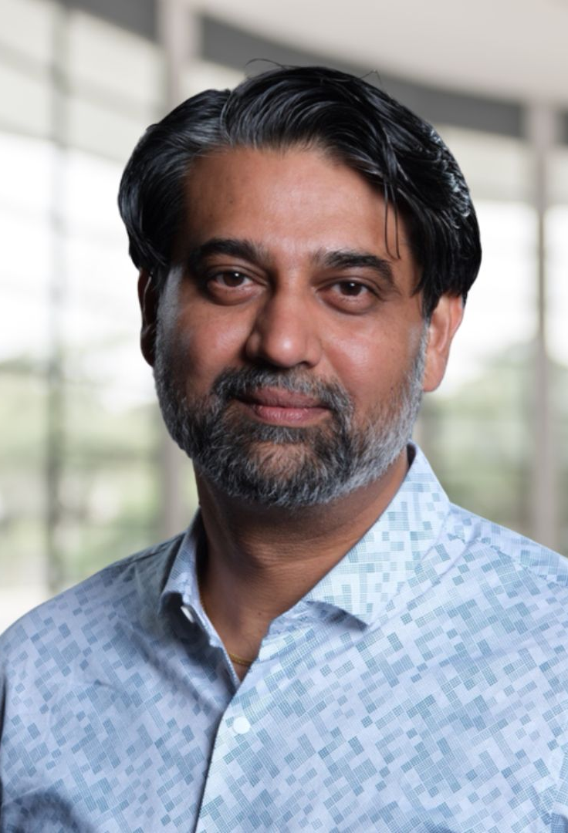
Introducing Dhaval Panchal
Founder of Evolve Agility
Scrum Alliance Certified Enterprise Coach
Certified Scrum Trainer
Member of the Scrum Alliance Board of Directors
Notes:
Dhaval Panchal is an experienced executive, trainer, and organizational design consultant. Dhaval founded Evolve Agility, a principles-to-practices – consulting, coaching, and training consultancy. As a leader, he has enabled large-scale Agile transformations for companies in Oil & Gas, Banking, Insurance, Gaming, and Medical business domains. Dhaval is a Scrum Alliance Certified Enterprise Coach® (CEC), Certified Scrum Trainer® (CST), and this year he was elected to the Scrum Alliance Board of Directors for the 2024-2026 term. Dhaval, the mic is yours.

Slide 10
Break time .. see you at 10:30!
Notes:
Need to be back by 10:30 or so

Slide 11
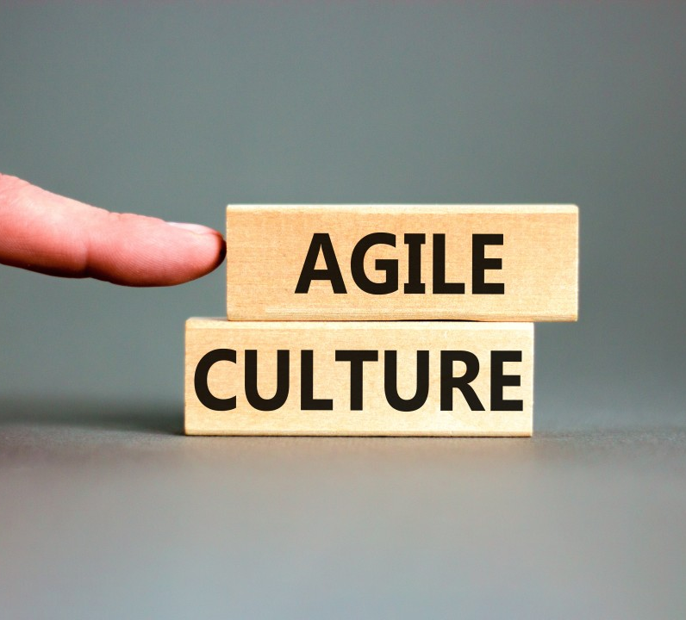
Seven Patterns of Great Agile Teams
Stephen
Notes:
I've been at VSP since 2017, after working in the private sector for … hmmm, way longer than I would have thought!
At VSP, I lead seven Agile teams. That wasn't always the case, and I'm going to talk this morning just a little bit about how we got to where we are today.

Slide 12
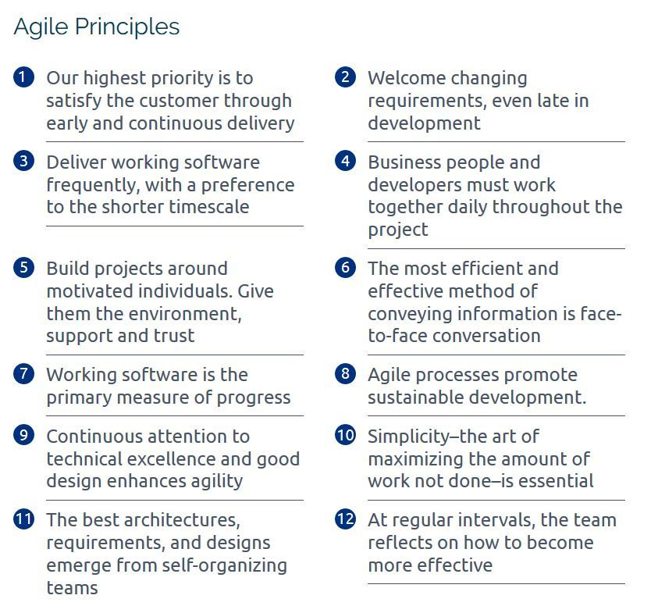
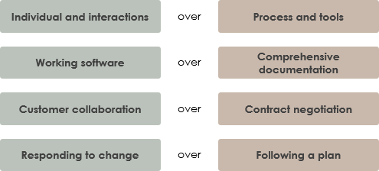
Notes:
If you’ve read much about agile, or been to any Agile training or seminars, you’ve probably heard about Agile Principles and Values. Here they are – there are 12 principles and four Values, and they're eloquently written, and they sound great. The problem I have with them is that they each require interpretation. If we accept that, for instance, we value Customer Collaboration over Contract negotiation, what does that mean for team behavior?

Slide 13
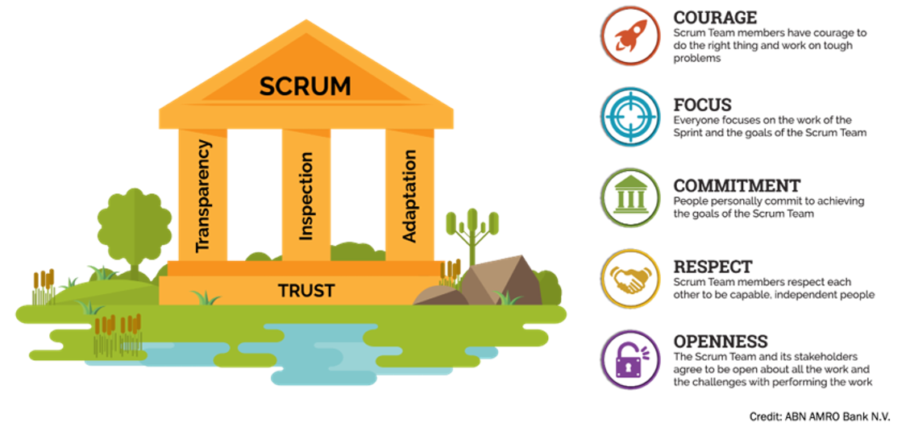
Notes:
If you decide to do Scrum, which is very likely, given the statistics on what Agile methods are most widely used, then you get Scrum Values and Pillars to add on top of the Agile Principles and Values. Anybody keeping track of totals? We now have 12 + 4 + 5 + 4 different values and principles – that's 25, if my math is right – and none of them explain in plain language just what, exactly, your teams are supposed to do today at 9:15 after their first cup of coffee. Add to that the language barrier we all face in IT – I have three primary languages represented in my relatively small shop of 50 or so, and English is not the most common.
In order to cement the behavioral changes we wanted when we started our Agile journey, I needed a clear, direct, simple way to say "this is how you should behave." … and that's where the Seven Patterns of Great Agile Teams came from..

Slide 14
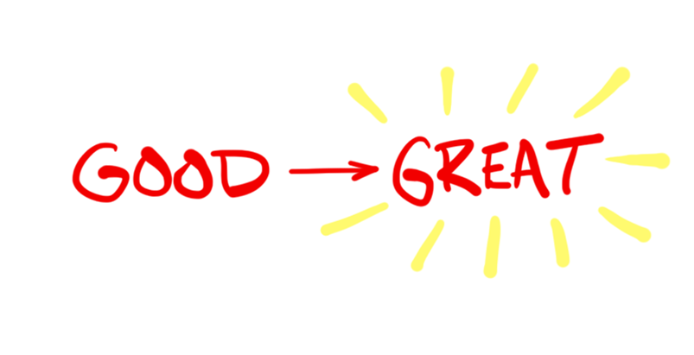
Seven Patterns of Great Agile Teams
We Trust Each Other
We Pursue Technical Excellence
We Are Truly Cross-functional
We Fully Engage in Agile Events
We Are Self-Managing
We Know Our Customer
We Deliver Business Value
Notes:
Here’s the list: Seven Patterns of Great Agile Teams. There’s still a problem here, though – I haven’t solved my “I need clear directions” problem. As you ‘ll see in a minute, this is just the summary level of the program – each pattern actually includes four or five examples of specific behaviors. They're easy to understand, they're easy to observe, and they’re easy to teach and track.
This all started a couple of years into our Agille transformation. When I was introducing the program to everyone, I told them that they had come a long way and were doing good work – but I wanted them to be great. So we call this the Good To Great program. That’s also a whole lot easier to say than “Seven Patterns of Great Agile Teams”.

Slide 15
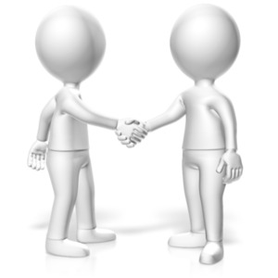
1.
We Trust Each Other
We encourage each other to fully participate in the team
We recognize each other’s great ideas
We embrace the feedback we receive
We have tough but gentle conversations when needed
Notes:
Here’s the first pattern – We Trust Each Other. [read examples].
Seeing this list for the first time, I can imagine some of you are thinking “that’s kind of an odd list of examples for trusting each other – and those first two don’t really go with the last two, do they?”
Well, Good to Great is all about changing behaviors that might hinder a team’s ability to deliver for our customers. One of those anit-patterns, or bad behaviors, is team members feeling left out or ignored. Another is people getting their feelings hurt or feeling attacked if someone tells them they’ve made a mistake, or are not being good teammates. Trust is built on people feeling safe to say what they truly feel without worrying about how other people are going to take it, so we encourage people being open to both receive and give criticism.
Incidentally, this is not the list of example behaviors that we started with. Since the program’s inception, we have updated the behavior examples four times. I get together with my supervisors and scrum masters every December and we go through all of the Good to Great patterns in sometimes excruciating detail. Remember, our goal is to provide positive examples of the behaviors we want our teams to exhibit … so our discussion is:

Slide 16
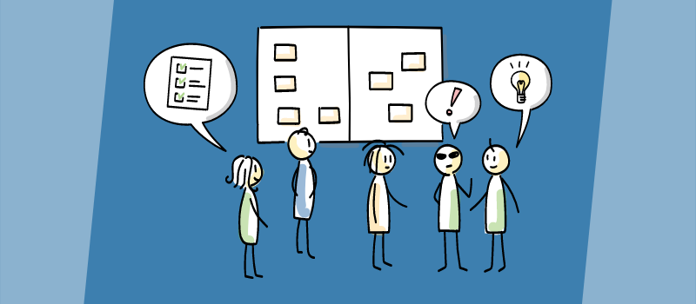
Good to Great Review
Any antipatterns to be concerned with?
Any patterns to celebrate?
Still an issue?
Notes:
Are you seeing bad behavior, or anti-patterns, taking root in your team that we need to counteract?
Are you seeing good behaviors, or patterns, that we want to encourage?
For each of the examples that we’ve had for the past year, is this something we still need to encourage, or has everybody “got it” now?
This is, at least in one way of looking at it, kind of a meta-retrospective on the whole department for an entire year. It’s a time that the agile leadership gets to think seriously together about how we’re doing as coaches and guides, and what behaviors we want to tackle or encourage next.
Out of this discussion, we come up with a set of four or five examples for each Good to Great Pattern to use for the next year.

Slide 17
We Pursue Technical Excellence
We look for opportunities to innovate and improve
We partner with each other on different technical approaches
We automate to improve our product’s security, stability, and deliverability
We are intentional in our pursuit of excellence
We continue learning and growing

Slide 18
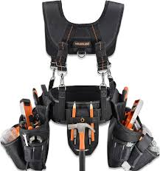
We Are Truly Cross-Functional
We think of ourselves as a team first
We organize work by skill set, interest, and availability instead of role
We cross-train to reinforce our cross-functionality
We help each other finish our stories on time
We help each other work through tough technical challenges

Slide 19
We Fully Engage In Agile Events
We clearly understand and support the value of each event
We create a plan for each day in our standup and we stick to it
We use every Event as an opportunity to collaborate and create value, not as “just another meeting”
We don’t wait for Retrospectives to improve how we work

Slide 20
We Are Self-Managing
We see when we’re falling behind on our plans and work together to get back on track
We expect each other to make commitments and reach goals
We recognize and help each other overcome interpersonal conflict
We appreciate how our individual contributions impact the team
We acknowledge when we need to improve, and we help each other to grow

Slide 21
We Know Our Customer
We constantly seek end-user feedback
We understand the “Why” before figuring out the “How”
We help our customers imagine what their product could be
We spend time watching our product being used
They Know Their Customer:
Know the business drivers
Regularly observe end users in their workspace
Help teach new features
Notes:
I’ll show you one more so you can see a little more of how we put this stuff together. We Know Our Customer: [read examples].
Just so you get an idea of how this particular pattern has evolved, here’s the example set from 2020. As you can see, we’ve felt the need over the years to be more and more specific about how we want our teams to learn about and participate with our customers – and how we want our customers to experience our partnership with them, and how they see us contributing to their business needs and opportunities.
There’s one other key difference here that I’ll point out. Up until this past year, the patterns themselves had never changed, and they were all written in third person- “Great Agile Teams Know Their Customer”. I had an epiphany last December and realized that I wanted our teams to start thinking in the first person. We are a great team, and therefore, WE know OUR customer.”
I don’t know how much of a difference that’s made, but it makes sense to me that as we continue to evolve and grow together, we internalize more and more of this message and these behaviors.

Slide 22
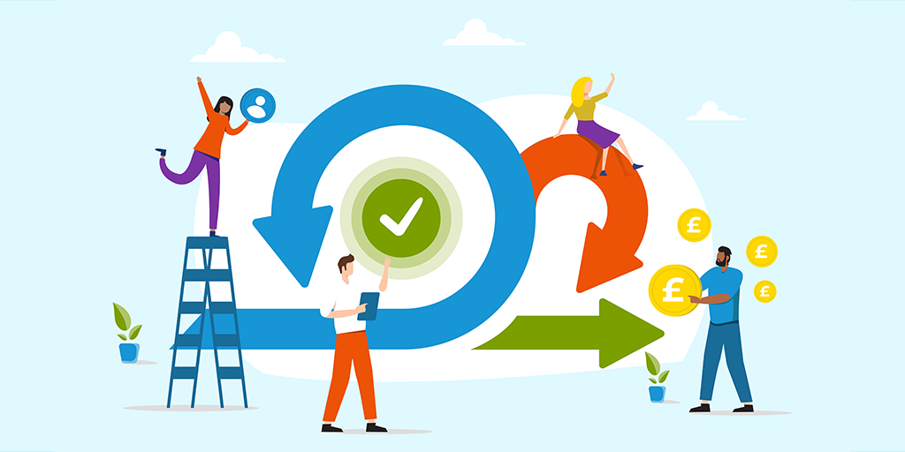
We Deliver Business Value
We understand our customer’s vision for the product’s future
We help our customers save time and money
We help our customers understand the business value of non-functional improvements
We deliver value through iterative deployment
We work with our customer to deliver the value they can use when they need it

Slide 23
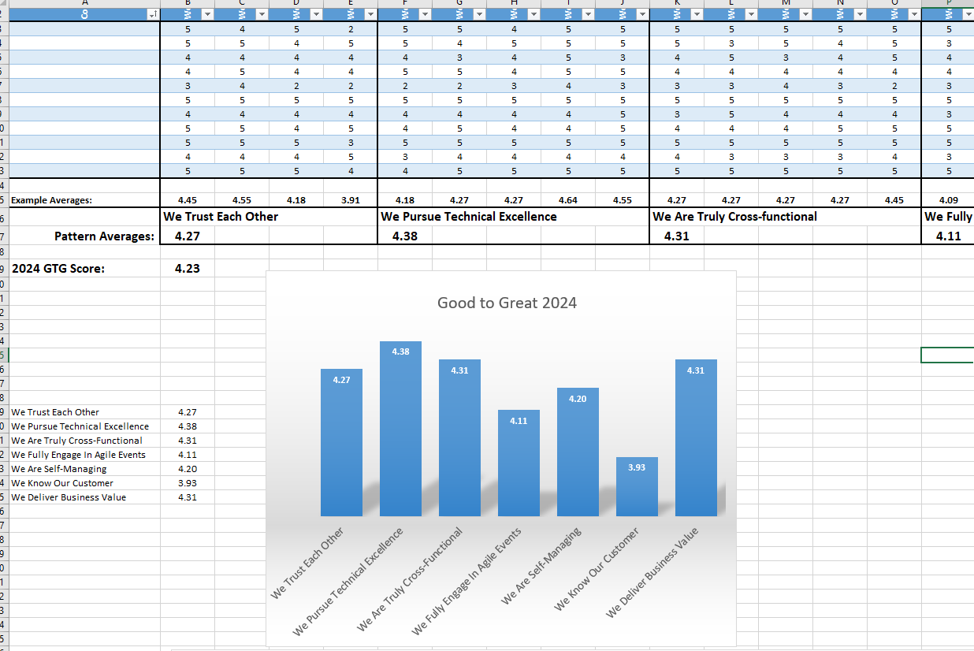
The Good To Great Calendar
December: GTG Program Update
January: Good To Great Month
Surveys, results, plans
Biweekly Town Halls
Every Sprint
Notes:
OK, that’s what the message is – now I’ll wrap up my segment with how we deliver that message consistently across all the teams and year after year.
It all starts in December. I get together with my supervisors and scrum masters (and that’s seven people) several times to review all of the pattern behavior examples. If this year goes like the last couple, that will take three or four meetings, and we’ll come out with a new “Seven Patterns of Great Agile Teams 2025”.
Then, January is Good To Great Month. Everyone takes a survey that asks for a rating from 1 to 5 on all 30 or so behavior examples, where 1 = “we never do that” and 5 means “we do this in our sleep”. The teams each get a report of their results – all of the individual scores for each behavior, anonymized for group consumption, and averaged scores for each pattern, and an overall Good To Great score. Here’s what that might look like for one team. The details continue off to the right, there, of coursed, but you can see that this gives the team all the details that they need to have some very interesting conversations. They’re required to hold a separate Good To Great Team Results Event by the firs week of February to discuss their numbers, and agree on an initial Good to Great focus for the coming year. In that conversation, they talk about things like:
What was our highest scoring pattern?
What was the lowest?
Are you surprised by this result, or does it make sense to you? Why?
There seems to be a lot of disagreement on this pattern – let’s talk about that.
How do we make the lowest score better, and the highest score even higher? [CLICK]
After getting that first survey done back in 2019, the next step for the program was to make it a part of normal team conversation – so Good to Great became a regular feature of the Town Hall that I have with ALL of my teams once every two weeks. The Town Hall is strictly timeboxed to 30 minutes, and a part of the agenda at every meeting is a lesson from the Agile Coach – so there’s a 10 or 15 minute chance twice a month for everyone on my team to hear me talk about how I expect them to behave. In addition to that, the scrum masters incorporate conversations about Good to Great and the Seven Patterns into every team retrospective, and the teams all pick some pattern example to work on and improve in the next sprint – and they talk about it in their sprint reviews and demos.
Any questions about the Seven Patterns or the Good to Great Program?

Slide 24
Notes:
I’ll close with this last graph. Because we’re capturing all of this survey data year after year, I know which patterns we need the most work on, which ones we’re strongest at, what our Product Owners think of our performance, and where we believe we’re getting better … and what happened in 2022. As you can see by our overall results year over year, we are making some headway on our journey to not just doing agile, but actually being agile, and I am as proud as I can be of the progress what we’ve made together, and will continue to make. One of the things that I am now telling our teams is that it is part of their job to get better every sprint. The Good to Great program is one way that we do that.
That’s the Good To Great Program, and how we’ve been able to focus 50 people’s attention on the specific behaviors that go into “being agile”. Now, I’m going to turn the mic over to one of our scrum masters to talk about the first pattern in more depth.

Slide 25
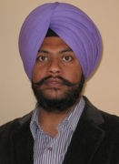
Great Teams Trust Each Other
Gurinderpreet
17 years in software development
10 years in law enforcement
Scrum Master for two teams at VSP
Notes:
Over 17 years of professional experience in Software Development Life Cycle methodologies like Scaled Agile Framework
Past 10 years working for Law Enforcement Agencies in USA (VSP) and Canada (Toronto Police services)
At VSP, Gurinderpreet is a Scrum Master for two of our teams.
As he says, "I’m here to support and empower our teams to navigate the journey of delivering valuable products together. My role is to facilitate our Scrum process, foster collaboration and ensure that we continuously improve as a team."

Slide 26
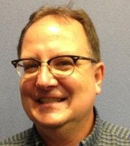
Great Teams Know Their Customer
Tim
Project Manager at VDOE
Former Agile Coach at VSP
Agile Coach last ten years
Notes:
Tim Roesch is currently a Project Manager at the VDOE and was the Agile Coach at VSP.
He did something that looked like eXtreme Programming in the late 80’s and he did something that looked like scrum in the early 2000’s.
He was at Capital One when they went through their large Agile Transformation in the early 2010’s and has been an agile coach for the last 10 years.

Slide 27
Retrospective
Niaz
Project Manager at VSP
20+ Years in the Software Industry
Professional Certifications in Project Management and Scrum

Slide 28
Closing Comments
Friday, February 28, 2025
for
CAAC15
Barbara Philips | Julie Wilson | Sharmila Thokala
David Crighton | Michael Vizdos | Stephanie Williams-Hayes
Dhaval Panchal | Mohan Seemakurthi | Tim Roesch
Gurinderpreet Mann | Niaz Allahbaksh | TJ Johnson
caac@vsp.virginia.gov
Notes:
Thanks to each of you for spending the morning with us. Believe me, we do not underestimate the investment that you and your agency are making by your being with us for three hours, and we really appreciate your being here.
Also, my heartfelt thanks to the members of the CAAC Planning team. Without this group, these events would not happen. If you’d like to take a more active role in upcoming Agile Conferences, the CAAC Planning Team is always looking for new members – just drop us a line at caac@vsp.virginia.gov.
Thanks again, folks – CAAC15 will be on Friday, February 28th. Mark your calendars, and we’ll look forward to seeing you then!

Slide 29
REFERENCES
How to find us: vsp.virginia.gov/caac
Or email to: caac@vsp.virginia.gov
Richmond Area Agile Events/Groups
Agile Richmond agilerichmond.com
Scrum RVA meetup.com/Scrum-RVA
Capital Kanban meetup.com/Capital-Kanban
Certifications / Training
Scrum Alliance scrumalliance.org/get-certified
PMI pmi.org
IIBA iiba.org
Atlassian Jira atlassian.com/software/jira
Atlassian Confluence atlassian.com/software/confluence
Evolve Agility https://www.evolveagility.com

